Slide 1
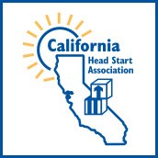

Slide 2
What comes to mind when you see the logo?
What is our identity?

Slide 3


These famous and highly recognizable brand logos remind consumers what the company will deliver on.
Technology – edgy and expensive with high cool factor.
“Think different.”
Athletics and victory.
“Just do it.”
A small team of board members spent several months really digging down into this question: What will we deliver on?

Slide 4
Values of our brand
Core Value: Advocacy
Action Values: Professional Development, Communication, Connectivity
Experience Values: Engagement, Unity, Support
From these values we constructed our core message…

Slide 5
Core Message
CHSA advocates for its members at the federal, state and local county level ensuring that members can speak with a unified voice about the challenges facing California’s most vulnerable families, and the Head Start community that serves them.
From our core message we created our tagline …

Slide 6
Tagline
Connecting * Engaging * Advocating
for our highest needs children
This tagline is what we used to design a logo.
Which brings us back to …

Slide 8
The CA name is bigger than the Head Start name.
The Head Start logo is much smaller than the CA map logo.
Notes:
Note

Slide 9
As the logo is reduced size for letter head or business cards …

Slide 10
As the logo is reduced size for letter head or business cards …
… the Head Start image becomes difficult to see.

Slide 11
Let’s look at the Head Start logo more closely …

Slide 12
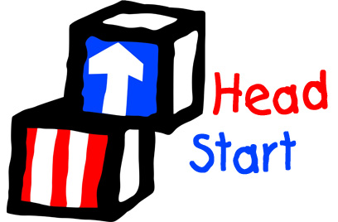

Slide 13
If we remove the words…

Slide 14
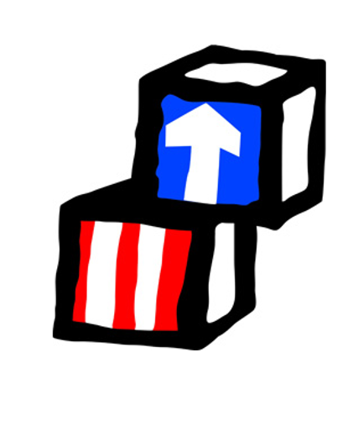
… the image elements are two blocks: 1 with stripes and 1 with an arrow. And the more powerful image …

Slide 15

… is the arrow.
Symbolizing “moving up” – i.e., improving the outcomes for the children and families we serve, but also growing our voice as advocates

Slide 16
We developed a California take on this by:
Simplifying the image
Adding CA color and new dimension
Building on the idea of “upward movement “

Slide 17


Slide 18
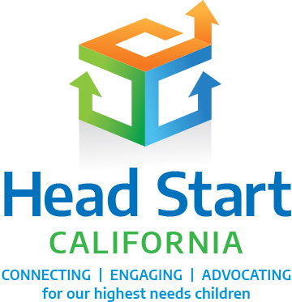

Slide 19
Our new name tells the world we are the Head Start community in California – in that order.
Our new tagline captures our commitments as a professional community – and for whom.
Our new logo is reminiscent of the traditional Head Start symbol (“blocks and arrow”) but conceived in a modern, forward-thinking design. We are – all of us - moving up. We are getting stronger as a professional community, lifting up the families we serve, and leading Head Start advocacy in California and nationally.

Slide 20
1965
1995?
2019

